Slide 1
FDSN Working Group III Agenda
12:00 Welcome and Introductions
Sign in sheet
Approval of 2013 WG III Minutes
Review of Charter for WG III
  Any suggested modifications to charter
12:15 Review of Existing FDSN Services and possible changes? Related to service interfaces not XML
Event service modifications
Station service modifications
Dataselect
Recommendations for New FDSN Services
12:30 FEDERATING THE FDSN DATA CENTERS
Status and Expansion of Federated Data Centers
    Status in Europe and Future Plans (powerpoint 2) Strollo/Pequegnat
  IRIS plans Ahern
  Other known efforts (Asia, North America, Latin America) Ahern
Review of the IRIS Federator with a short demonstration Trabant
Creating an FDSN Federator Ahern
  Business Rules Establishing Primary and Other Centers
  Considerations that should be included

Slide 2
FDSN Working Group III
Agenda (cont)
13:15 FDSN QUALITY ASSURANCE
Overview of Quality Assurance Efforts in the FDSN
Plan from 2013 was to see how MUSTANG develops – current status Ahern
IRIS MUSTANG – implementation as services Ahern
EIDA QA Status (powerpoint 3) Trani
FDSN Quality Assurance
FDSN Coordination – possible needs
Service definitions for metrics
  XML definitions
Sharing Algorithms for metrics
14:15 PRODUCTS
Review of products across the FDSN
  EIDA (powerpoint 4) Strollo
  IRIS (mention of DOIs) Trabant
  Other groups
14:45 DOIs
Status of DOIs for Seismic Networks Ahern
Other activities in the FDSN regarding DOIs
DOIs – what is next?
How do we get networks to mint DOIs and register them with the FDSN
15:00 ADJOURN

Slide 3
FDSN WG III
Approval of 2013 WG III Minutes
Review of Charter for WG III
  Will coordinate the production of standard products and the methods for producing these products,
  Will coordinate the identification, development and/or distribution of standard software applications used to acquire, manage, distribute, and use data from FDSN data centers,
  Will coordinate the development and adoption of standards for services, including web services and other data center services, that are supported and deployed at FDSN centers.

Slide 4
Review of Existing FDSN Services and needed changes?
(Related to service interfaces not XML)
Event service modification
Station service modifications
Dataselect
  Match timeseries option
Recommendations for New FDSN Services
  Timeseries as a standard service of the FDSN
  SAC P&Z and RESP service
  Rotation Service
  Metadata changes service

Slide 5
Status of FDSN Services
EIDA status
IRIS/US Status
IRIS Plans related to CoopEUS

Slide 6
IRIS – US and non-European Services
Plans to Deploy Services – work started
  Canada, SCEDC, New Zealand
Plan to Deploy Services – no work started
  Mexico, interest in LACSC area
IRIS CoopEUS Activities
  Plan to hold workshop to promote Federated Centers in Western Pacific and SE, NE, Central Asia
  CAS, CENC, KMA (Korea), Japan, Taiwan, New Zealand, several partners in SE Asia

Slide 7


IRIS Federator:
Facilitating cross-center data access
FDSN dataselect and station services running at 13 data centers
(more coming):

Slide 8
IRIS Federator
Overview
Two main components:
Composite catalog of time series channels
  Updated nightly
Service for querying the catalog:
  http://service.iris.edu/irisws/fedcatalog/1/
The fedcatalog service is designed support client-side federation. The user’s data collection software contacts each center directly to retrieve data. Time series and related metadata do not flow through a central node.
Federation capability is being integrated into DMC tools and community-developed toolkits.

Slide 9
IRIS Federator
Removing duplicates
By default, but can be overridden, the IRIS Federator removes any duplicated channels in a result set as a service to the user. This is implemented using a flexible set of rules and is used to direct data requests to the primary data centers whenever possible.
These rules have greater granularity than NetDC
Rule tests can be network, station, location, channel and/or time window. In the IRIS Federator currently it is by Network and Time only in its early stages
GEOFON: GE ORFEUS: NL RESIF: FR
NCEDC: BK,NC SED: CH INGV: MN,IV,GU
KOERI: KO BGR: GR IPGP: G
LMU: BW NIEP: RO USPSC: BL,BR,Y4(2013)
IRIS: many other permanent and temporary networks/experiments

Slide 10
Demonstration of Federator – Internet Willing

Slide 11
Current Status in Europe related to a Federator/Moderator
    Powerpoint 2 from Catherine Pequegnat

Slide 12
Developing an FDSN Federator
Developing the Rules
What things should be considered
  Reliability
  Politics
  Proximity
  Scalability
What role do secondary centers play?

Slide 13
Quality Assurance
2013 plan from Gothenburg was to see how MUSTANG would develop
Status of MUSTANG

Slide 14
What is MUSTANG?
MUSTANG is an automated data quality assurance system that stores measurements of seismic data quality for the entire IRIS archive (in progress) and makes them available to the community through web services.
Currently, 45 metrics are calculated.
The system is modular; new metrics can be added readily.
MUSTANG will have the capability to automatically update metrics values when the data, metadata, or algorithms change.
MUSTANG Presentation on Wednesday at 13:45 in
Session S01g/S11

Slide 15
The MUSTANG System
IRIS SEED Archive
Metadata
database
Real time
miniseed
miniSeed
archive
Contributed metrics
MUSTANG
Metrics job
Metrics scheduler
Metrics database
Metrics updater
Metrics job
Metrics job
MUSTANG clients
MUSTANG Databrowser
LASSO
Scripts etc
Web service call
Other communication
graphics
Text-based data
Other Analysis software

Slide 16
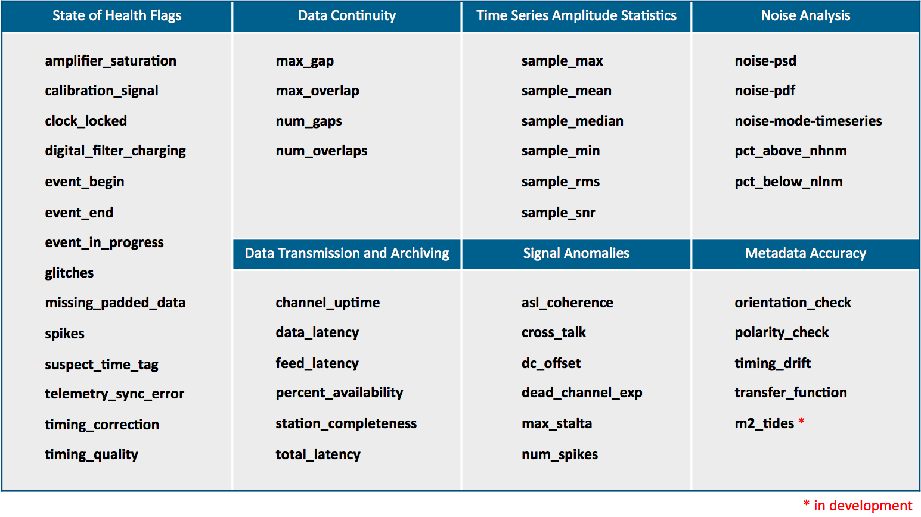
MUSTANG
46 Metrics Available
* in development

Slide 17
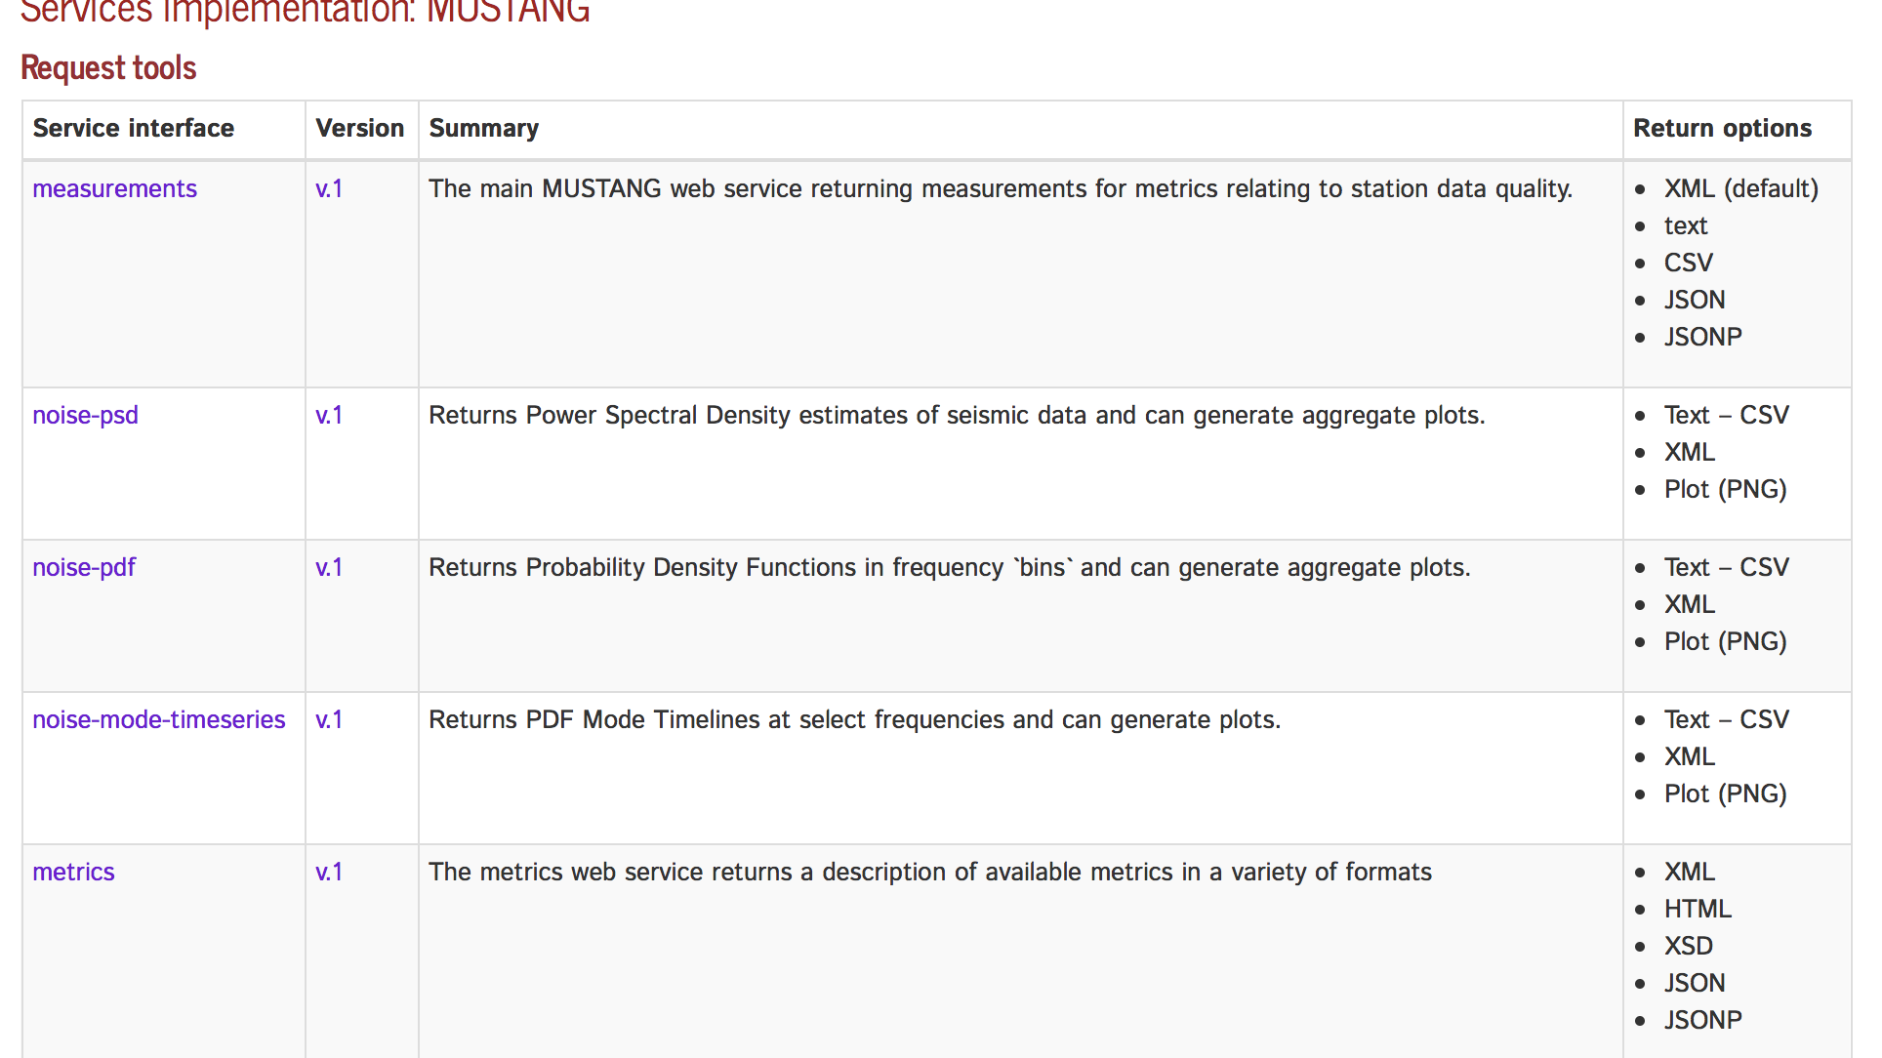
service.iris.edu/mustang/

Slide 18
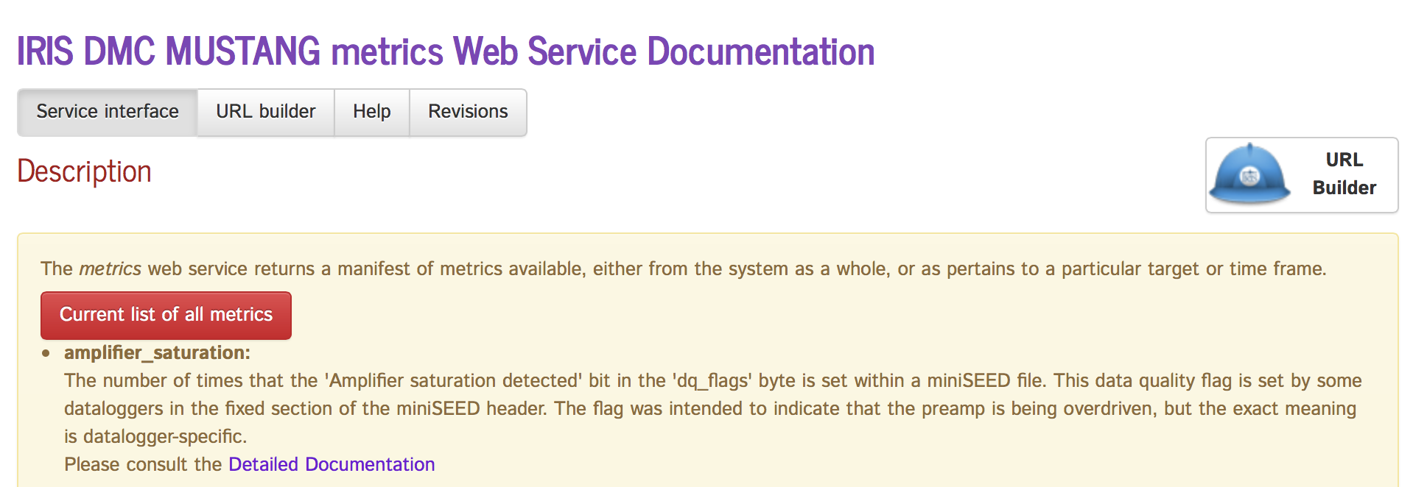
MUSTANG Web Services
http://service.iris.edu/mustang

Slide 19
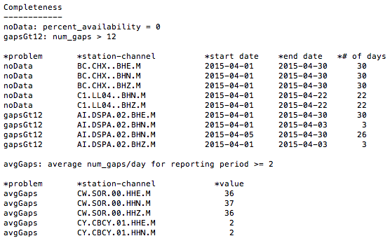
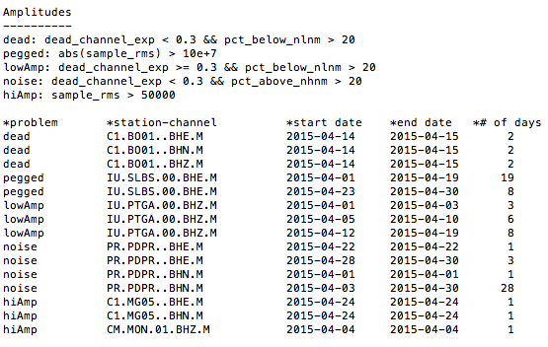
Automated Text Reports for internal analyst use
Created by script using MUSTANG metrics
Groups metrics into problem types
Quick way to focus on problem stations for further review

Slide 20
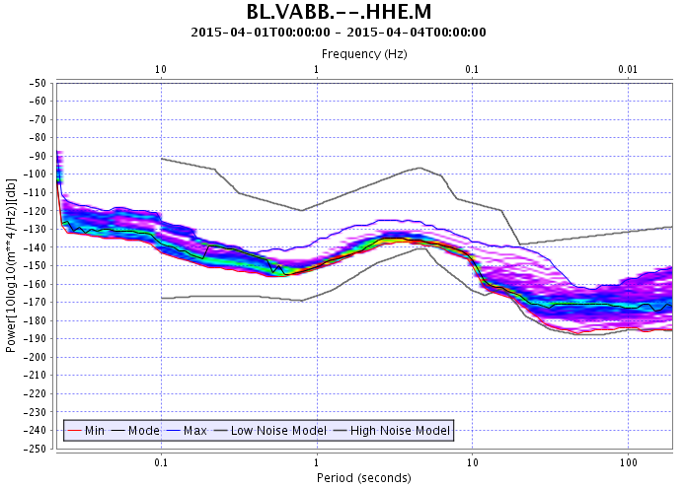
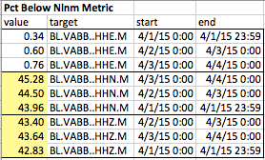

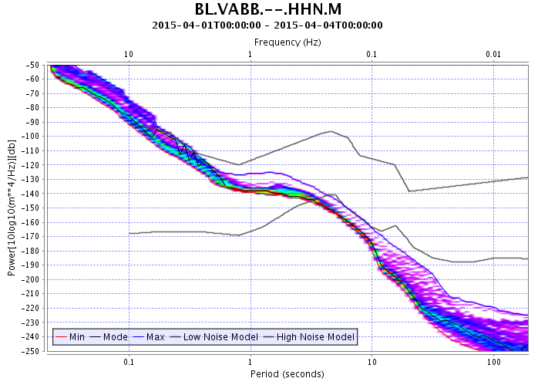

Example: Response Error Found Using the pct_below_nlnm Metric
X
(the percent of PSD values that are below the New Low Noise Model)
HHE poles:
HHN poles:
Sign error

Slide 21
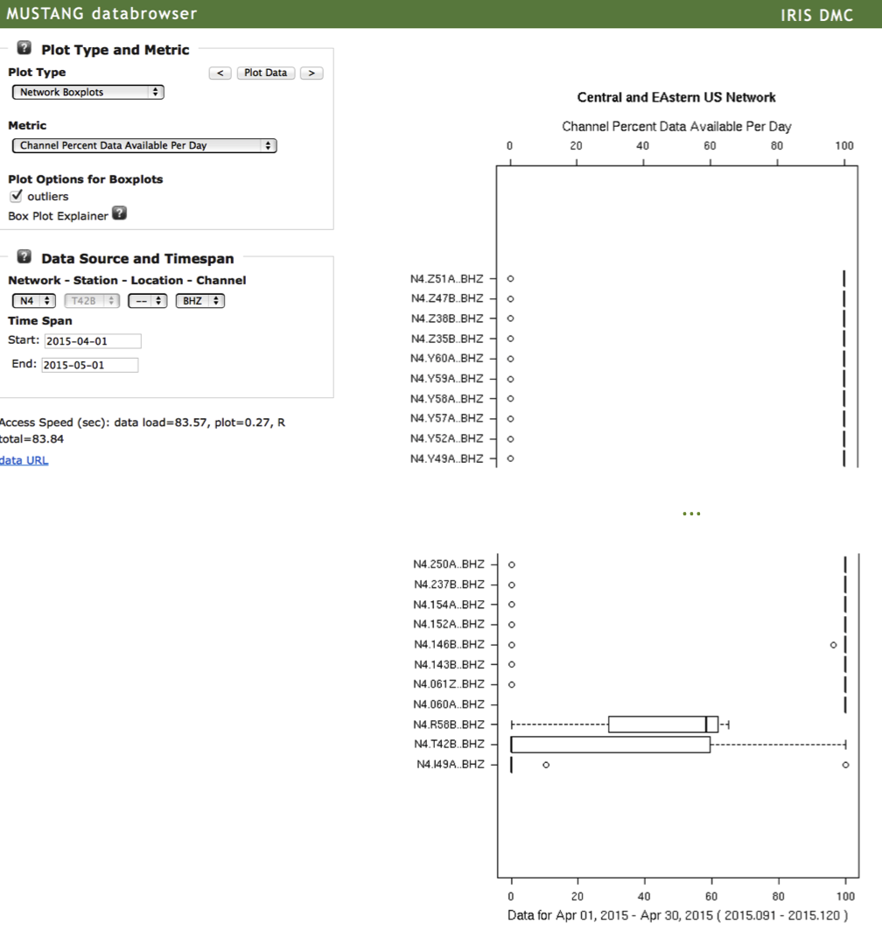
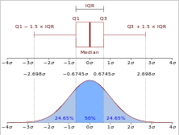
Example: Data Completeness
percent_availability metric (channel percent available per day)
Box plot illustration from Wikipedia
MUSTANG Databrowser Network Boxplots

Slide 22
Example: Channel Orientation Analysis
X
The orientation_check metric finds observed channel orientations for shallow M>= 7 events by
  Calculating the Hilbert transform of the Z component (H{Z}) for Rayleigh waves
  Cross-correlating H{Z} with trial radial components calculated at varying azimuths until the correlation coefficient is maximized
  The observed channel orientation is difference between the calculated event back azimuth and observed radial azimuth
Stachnik, J.C., Sheehan, A.F., Zietlow, D.W., Yang, Z, Collins, J. and Ferris, A, 2012, Determination of New Zealand Ocean Bottom Seismometer Orientation via Rayleigh-Wave Polarization, Seismological Research Letters, v. 83, no. 4, p 704-712.

Slide 23
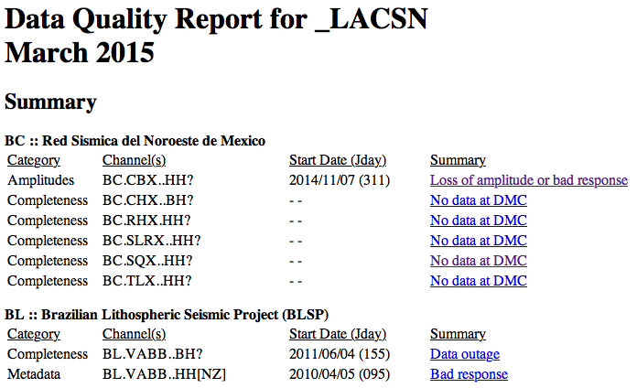
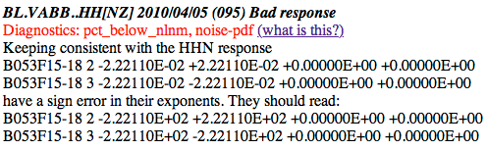
Network Operator Reports
Prototype of final product after analyst review verifying accuracy of station issues
Links to analyst assessment of issue
Virtual network report
summarized by network

Slide 24
What is MUSTANG’s biggest challenge

Slide 25
QA Efforts within EIDA
Powerpoint 4- Strollo

Slide 26
Data Products
Efforts at the IRIS DMC

Slide 27
Higher level data products
http://ds.iris.edu/ds/products/
USArray ground motion visualizations
Event plots
Aftershock sequences
EQ energy & duration
Source-time functions
Back projections
ShakeMovie 3D synthetics
And more…
Receiver functions
Earth Model Collaboration
Infrasound (USArray TA)
  Reference event database
  Detection catalog
Global CMT solutions
Ambient Noise CCs
Empirical Greens Tensors
Surface wave phase velocity measuring system

Slide 28
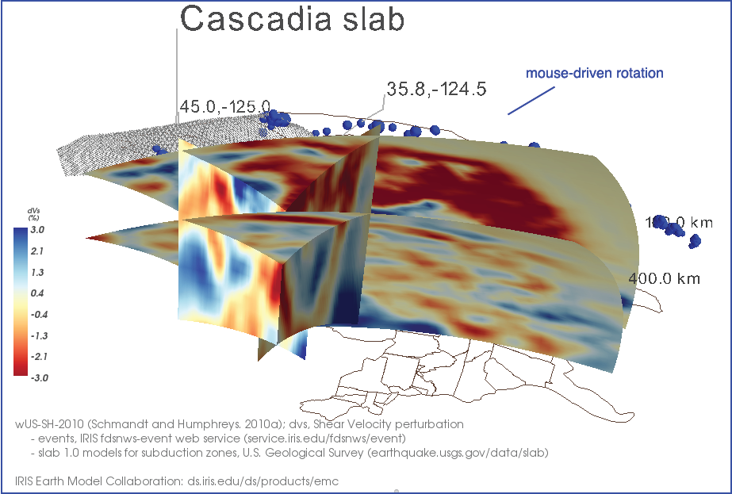
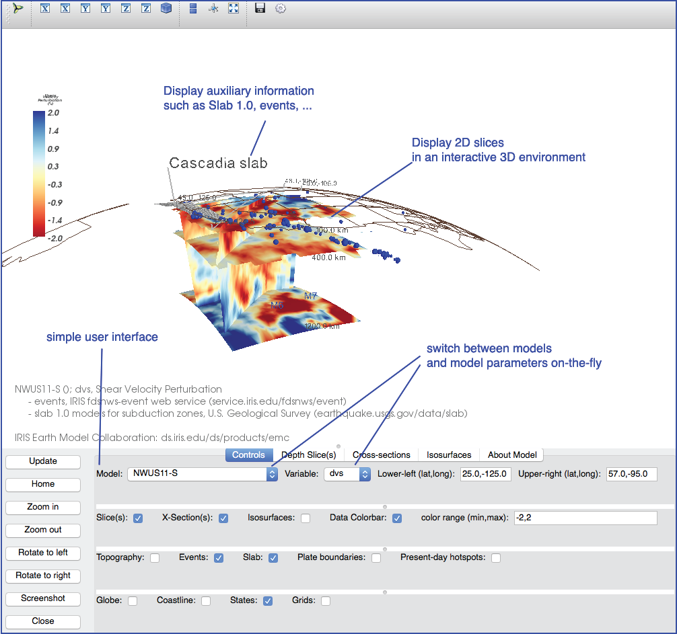
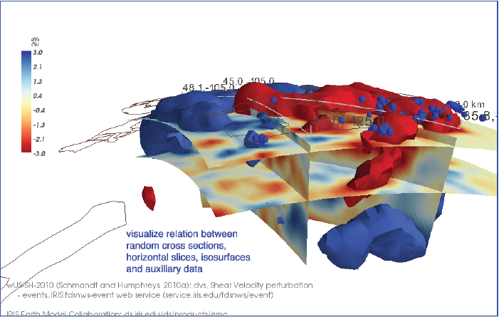
EMC 3D Visualization
Relatively simple, Python-based Earth model desktop visualization tool.
Designed for IRIS EMC models, but works with general netCDF volumes.
Come see the poster.

Slide 29
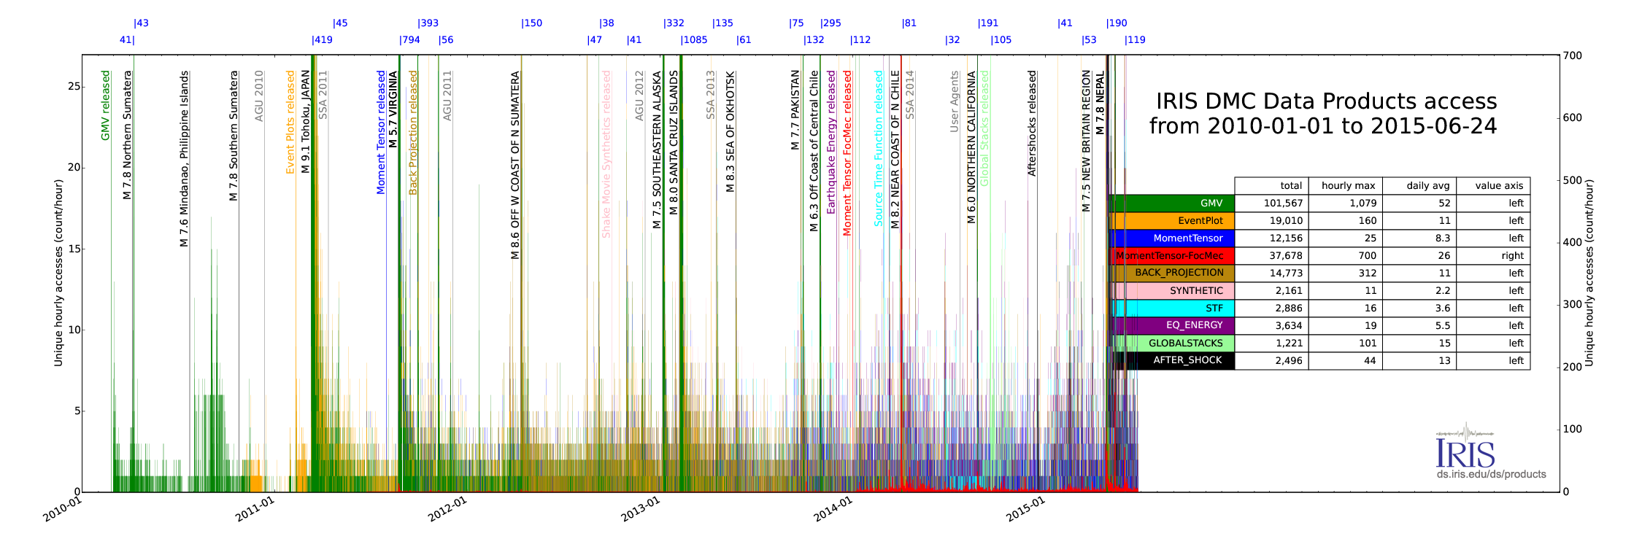
Data Product Usage
Average data product access rate: 4-6 per hour

Slide 30
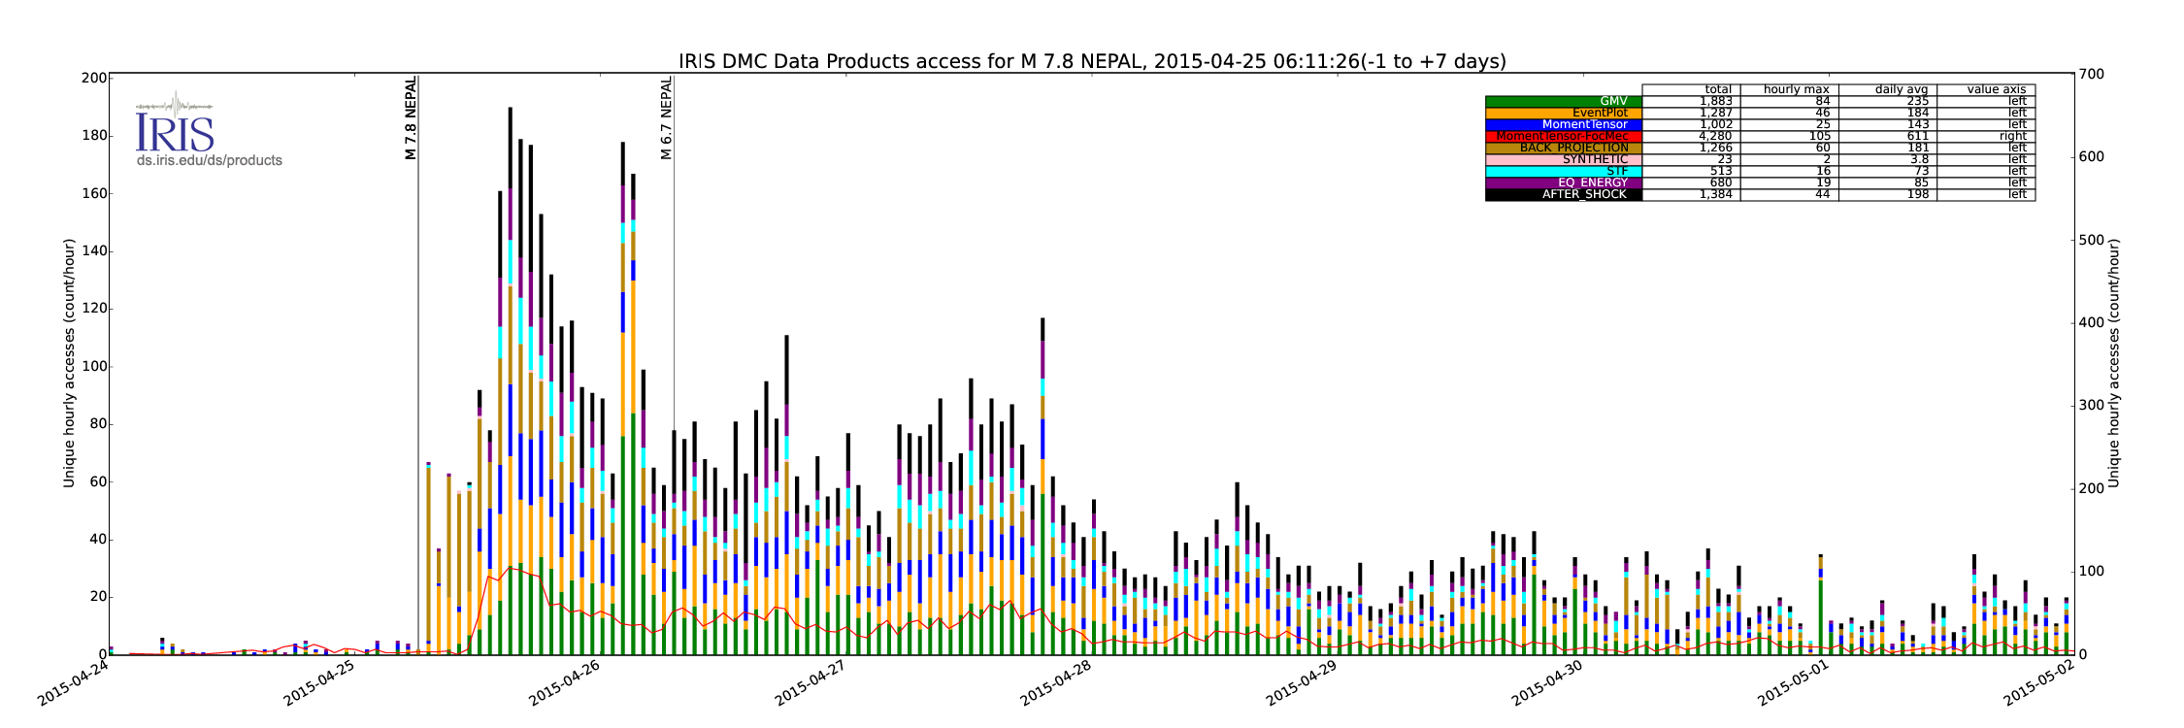
Data Product Usage
Peak activity is event-related, e.g. 2015-5-25 Nepal M 7.8

Slide 31
FDSN Digital Object Identifiers
IRIS has revamped the FDSN Network pages significantly
  Off of Oracle and into PostgreSQL
  The FDSN is totally isolated from DMC operations through a dedicated virtual machine
Requesting a Network Code
  http://www.fdsn.org/networks/request/perm/
Now has a section related to NETWORK CITATIONS

Slide 32
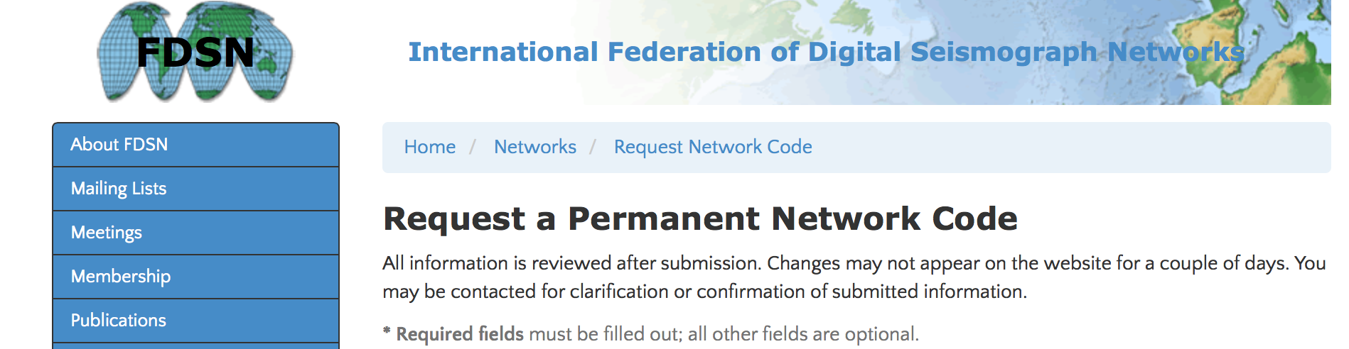
Totally FDSN Branding
http://www.fdsn.org/networks/request/perm/

Slide 33
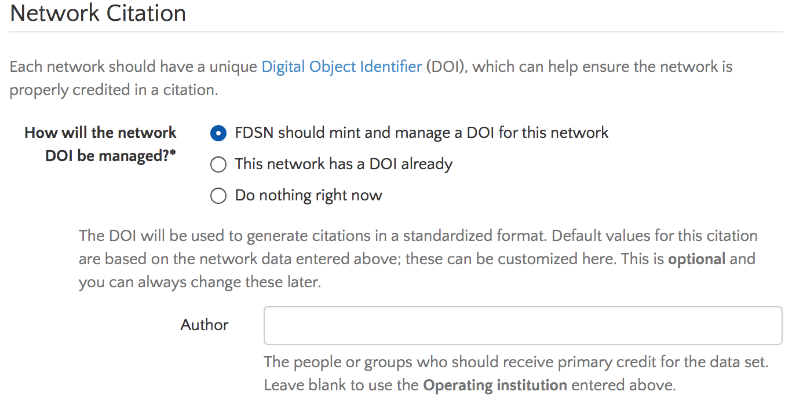
Previous information is now augmented with Network Citation

Slide 34
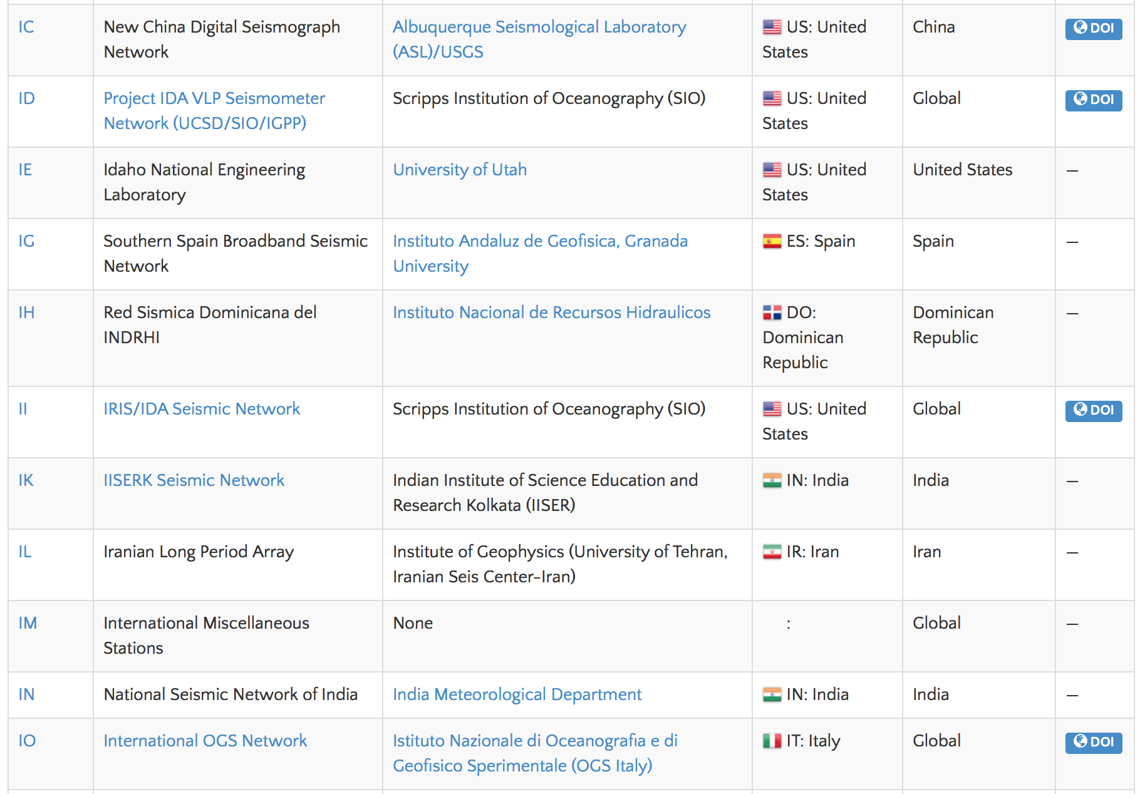
FDSN Networks Page http://fdsn.org/networks/

Slide 35
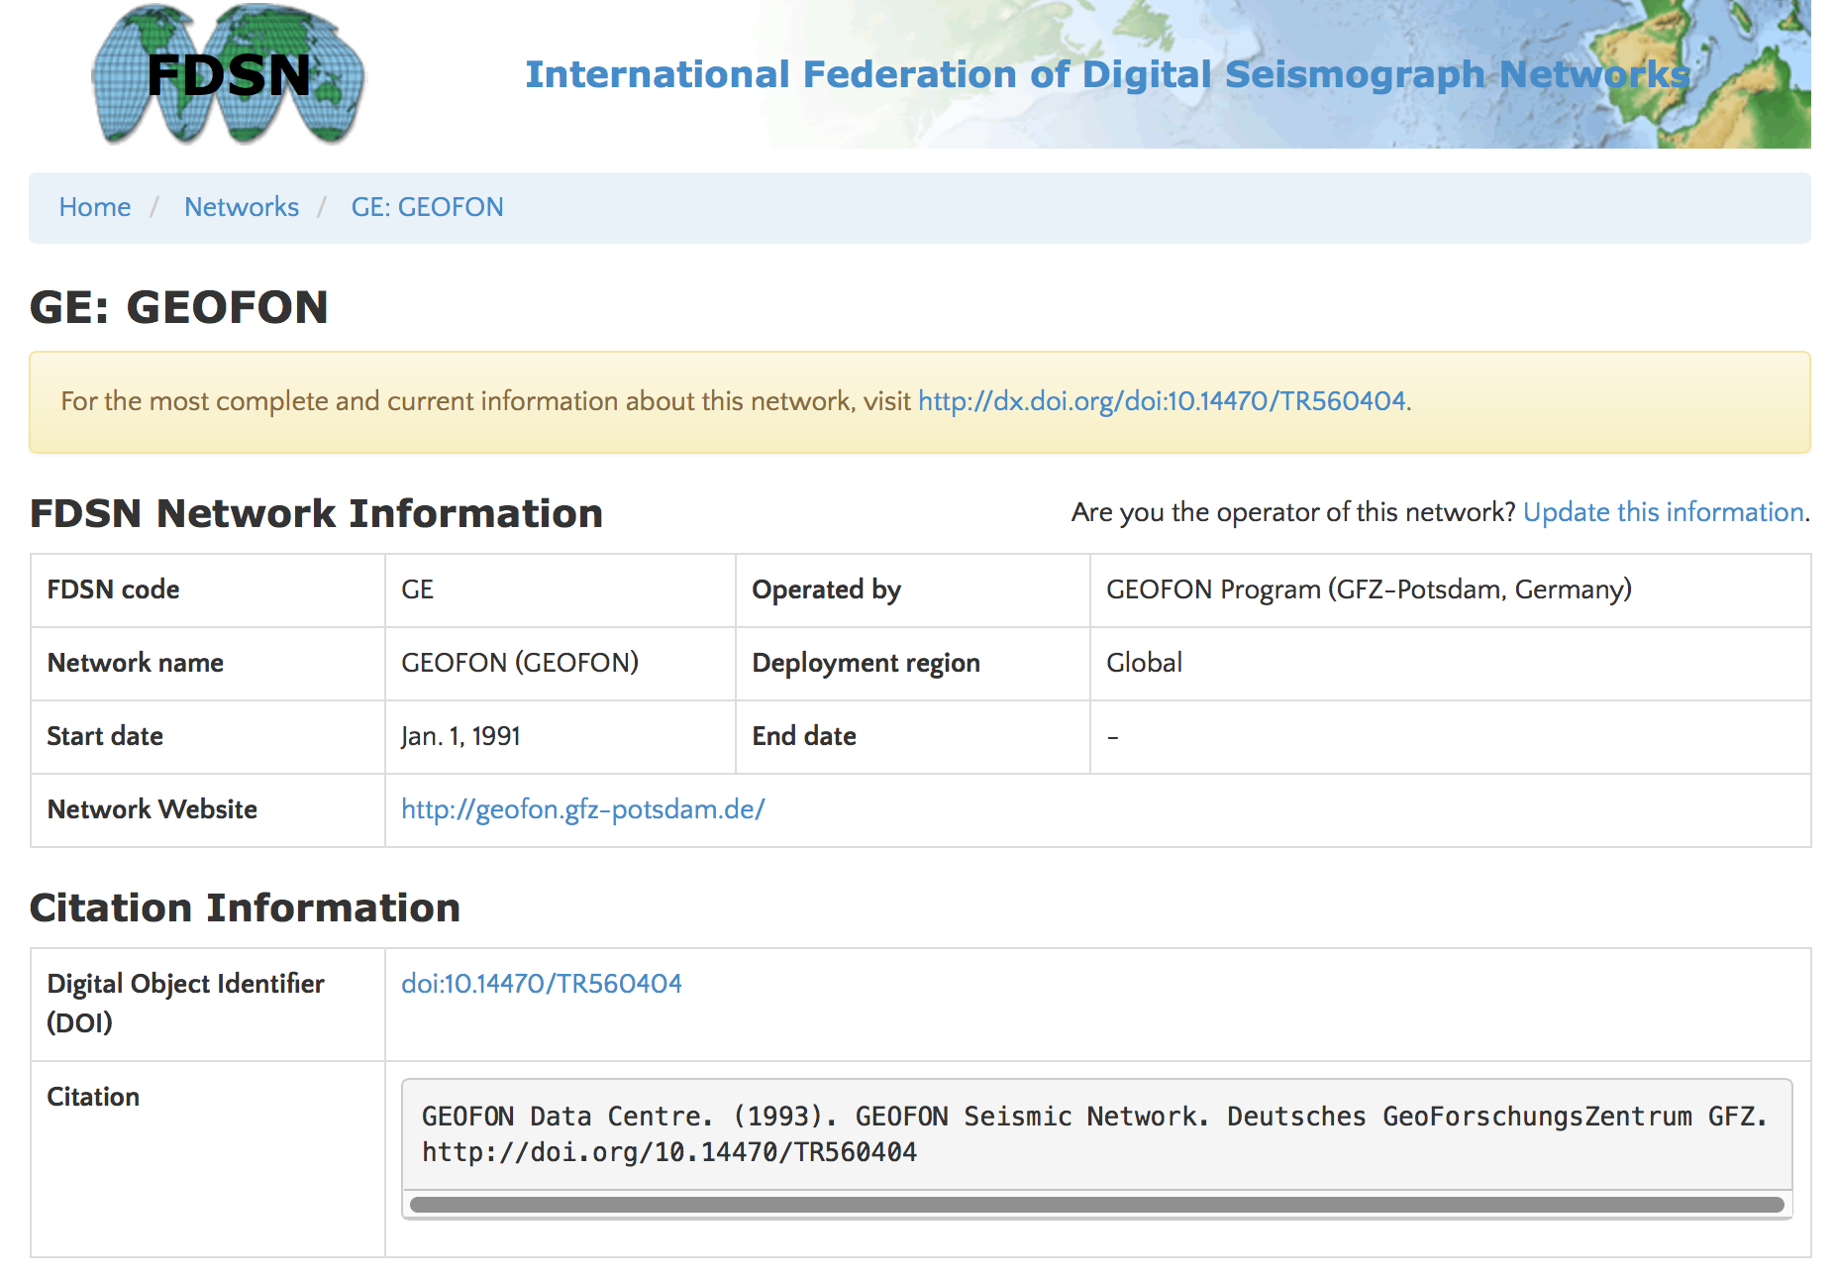
Example Landing Page

Slide 36
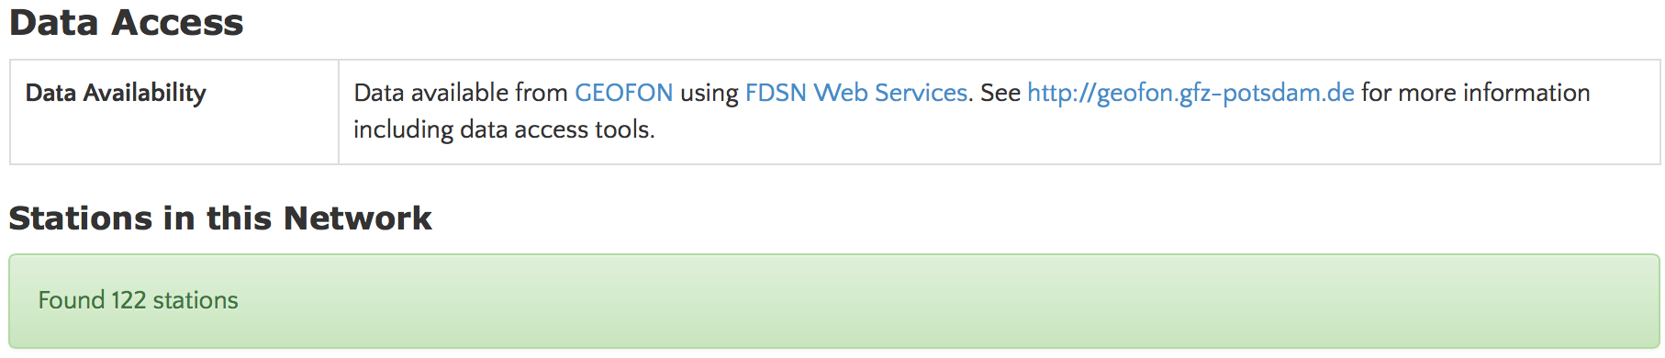
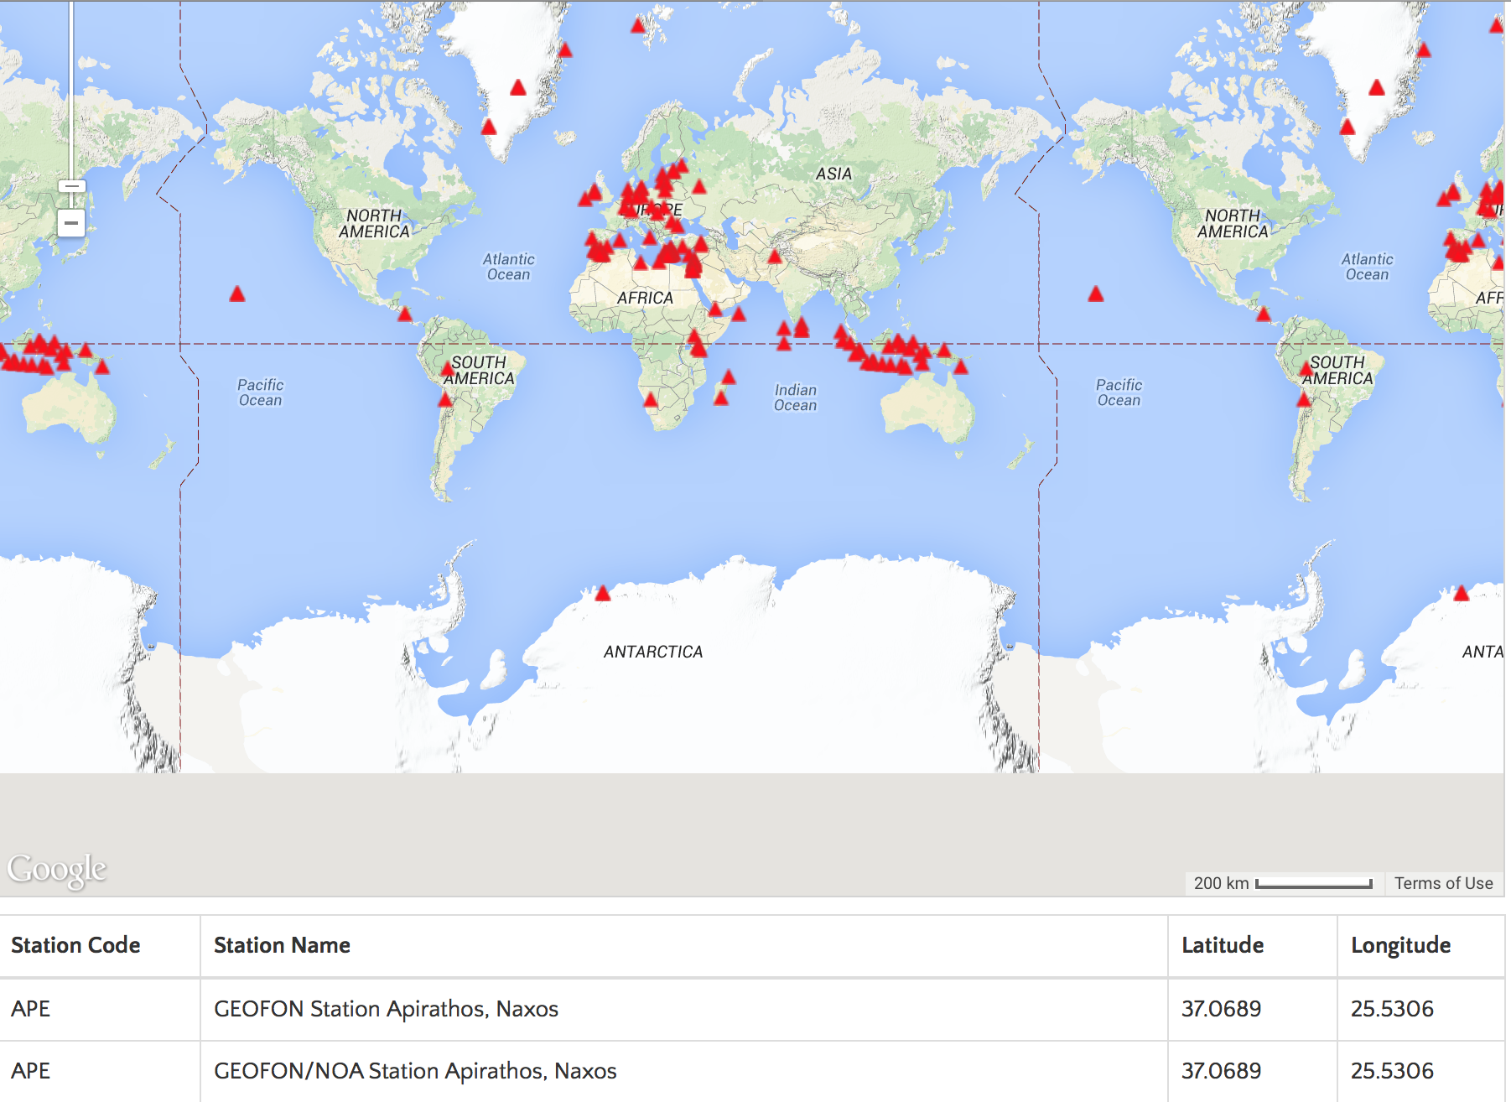
Stations lists and maps generated dynamically using FDSN services if availble

Slide 37
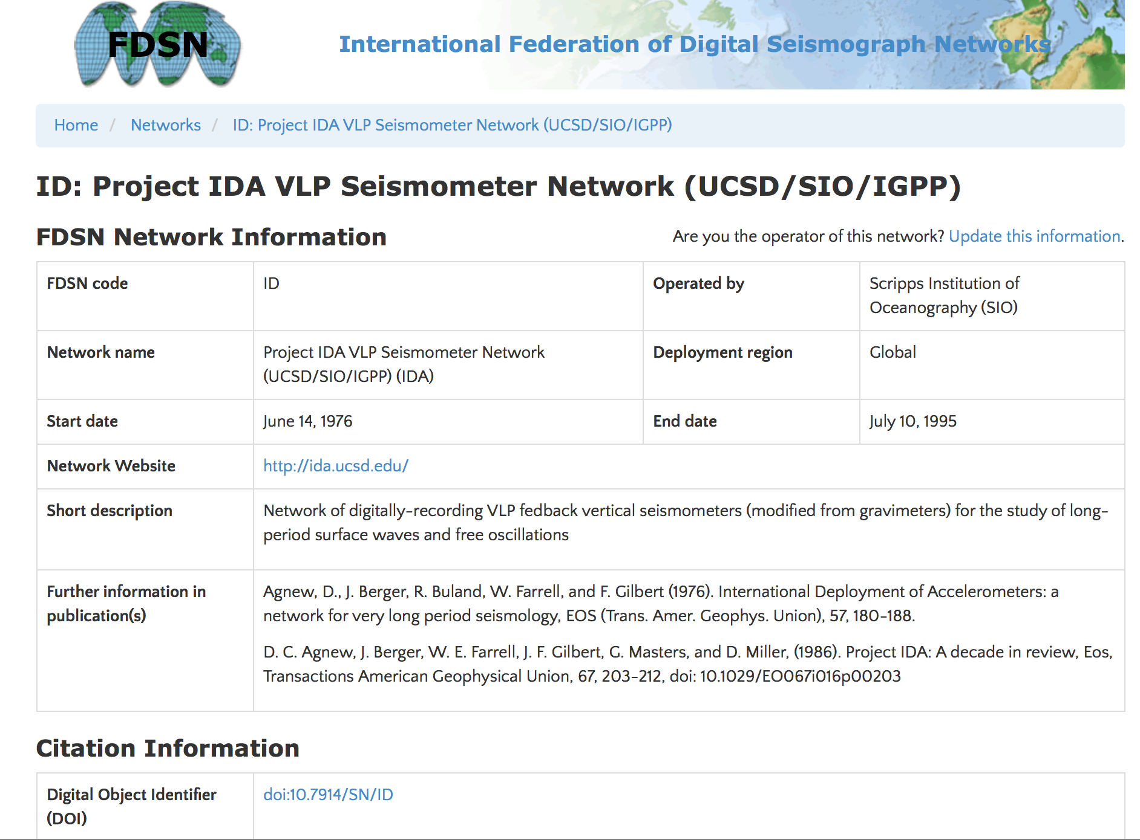
Another Example with Publications

Slide 38
Important Next Steps for DOIs
Let people know some exist
IRIS DMC will include DOIs in qurterly summaries sent to
  Users receiving data from the IRIS DMC
Permanent networks
  366 network codes assigned
  22 DOIs
Temporary Networks
  767 network codes assigned
  11 DOIs

